Slide 1
Cryptography and Network Security
KERBEROS

Slide 2
Session Meta Data
Author | Dr T Sree Sharmila
Reviewer
Version Number | 1.0
Release Date | 1 August 2018

Slide 3
Revision History
Revision Date | Details | Version no.
 |  | 1.0

Slide 4
Agenda
Introduction
Motivation
Requirement
Kerberos V4
Kerberos Realms
Kerberos V5
Summary
Test your understanding
References

Slide 5
Kerberos - Introduction
Kerberos is an authentication service developed as part of Project Athena at MIT, and is one of the best known and most widely implemented trusted third party key distribution systems.
Kerberos provides a centralized authentication server whose function is to authenticate users to servers and servers to users.
Unlike most other authentication schemes, Kerberos relies exclusively on symmetric encryption, making no use of public-key encryption.
Two versions of Kerberos are in common use: v4 & v5.
Notes:
Kerberos is an authentication service developed as part of Project Athena at MIT, and is one of the best known and most widely implemented trusted third party key distribution systems.
Kerberos provides a centralized authentication server whose function is to authenticate users to servers and servers to users. Unlike most other authentication schemes, Kerberos relies exclusively on symmetric encryption, making no use of public-key encryption. Two versions of Kerberos are in common use: v4 & v5.

Slide 6
Agenda
Introduction
Motivation
Requirement
Kerberos V4
Kerberos Realms
Kerberos V5
Summary
Test your understanding
References

Slide 7
Kerberos Motivation
Without knowledge of identity of person requesting an operation difficult to decide if it should be allowed.
Traditional authentication methods are not suitable for use in computer networks where attackers can monitor network traffic and intercept passwords.
Use of strong authentication methods is imperative.

Slide 8
Kerberos Motivation
In a common distributed architecture
Three approaches to security envisaged:
Rely on individual client work stations to assure identity of user.
Require client systems to authenticate themselves to servers.
Require user to prove identity for each service invoked.

Slide 9
Agenda
Introduction
Motivation
Requirement
Kerberos V4
Kerberos Realms
Kerberos V5
Summary
Test your understanding
References

Slide 10
Kerberos Requirements
its first report identified requirements as:
secure
reliable
transparent
Scalable
Clients and servers trust Kerberos to mediate their mutual authentication
Notes:
The first published report on Kerberos [STEI88] listed the requirements shown above. To support these requirements, Kerberos is a trusted third-party authentication service that uses a protocol based on that proposed by Needham and Schroeder [NEED78], which was discussed in Chapter 7.

Slide 11
Agenda
Introduction
Motivation
Requirement
Kerberos V4
Kerberos Realms
Kerberos V5
Summary
Test your understanding
References

Slide 12
Kerberos Version 4
Uses DES, in a rather elaborate protocol, to provide authentication
Uses an Authentication Server (AS)
Knows all user passwords, and stores in a DB
Shares a unique secret key with each server
Send an encrypted ticket granting ticket
TGT contains a lifetime and timestamp
Uses a Ticket Granting Server (TGS)
Issues tickets to users authenticated by AS
Encrypted with a key only known by AS and TGS
Returns a service granting ticket
Service granting ticket contains timestamp and lifetime

Slide 13
Kerberos v4
A Simple Authentication Dialogue
C -> AS: ID_{C}||P_{C}|| ID_{V}
AS->C: Ticket
C->V: ID_{C}|| Ticket
Ticket = E_{KV}[ID_{C}||AD_{C}|| ID_{V}]

Slide 14
A More Secure Authentication Dialogue
once per logon session
C -> AS: ID_{C}||ID_{tgs}
AS->C: E_{Kc}[Ticket_{tgs}]
once per type of service
C->TGS: ID_{C}|| ID_{V} ||Ticket_{tgs}
TGS->C: Ticket_{V}
once per service session
C->V: ID_{C}|| Ticket_{V}
Ticket_{tgs} = E_{Ktgs}[ID_{C}||AD_{C}|| ID_{tgs}||TS₁||Lifetime₁]
Ticket_{v} = E_{Kv}[ID_{C}||AD_{C}|| ID_{v}||TS₂||Lifetime₂]

Slide 15
Kerberos v4 Overview
a basic third-party authentication scheme
have an Authentication Server (AS)
users initially negotiate with AS to identify self
AS provides a non-corruptible authentication credential (ticket granting ticket TGT)
have a Ticket Granting server (TGS)
users subsequently request access to other services from TGS on basis of users TGT
Notes:
The core of Kerberos is the Authentication and Ticket Granting Servers – these are trusted by all users and servers and must be securely administered. The protocol includes a sequence of interactions between the client, AS, TGT and desired server.

Slide 16
Kerberos v4 Dialogue
obtain ticket granting ticket from AS
once per session
obtain service granting ticket from TGT
for each distinct service required
client/server exchange to obtain service
on every service request
Notes:
The full Kerberos v4 authentication dialogue is shown in Stallings Table 14.1, divided into the 3 phases shown above. The justification for each item in the messages is given in Stallings Table 14.2.

Slide 17
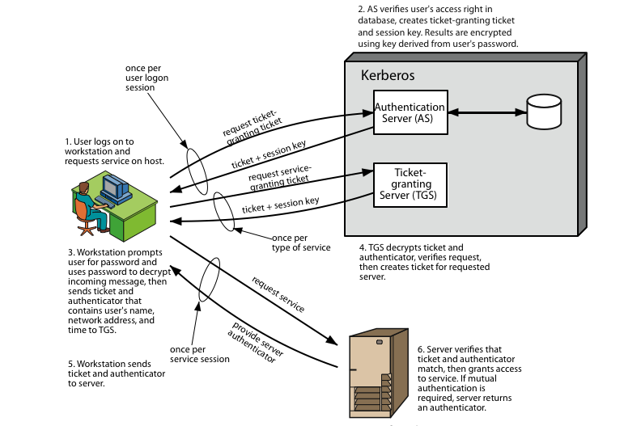
Kerberos 4 Overview
Notes:
Stallings Figure 14.1 diagrammatically summarizes the Kerberos v4 authentication dialogue, with 3 pairs of messages, for each phase listed previously.

Slide 18
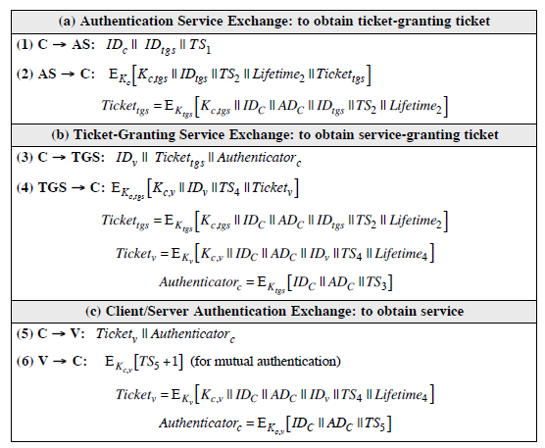
summary of Kerberos version 4 message exchanges

Slide 19
Rationale for the Elements of the Kerberos Version 4 Protocol

Slide 21
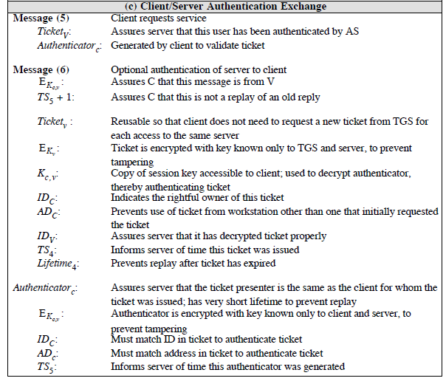

Slide 22
Agenda
Introduction
Motivation
Requirement
Kerberos V4
Kerberos Realms
Kerberos V5
Summary
Test your understanding
References

Slide 23
Kerberos Realms
A full-service Kerberos environment consisting of a Kerberos server, a number of clients, and a number of application servers is referred to as a Kerberos realm.
A Kerberos realm is a set of managed nodes that share the same Kerberos database, and are part of the same administrative domain.
If have multiple realms, their Kerberos servers must share keys and trust each other.
Notes:
A full-service Kerberos environment consisting of a Kerberos server, a number of clients, and a number of application servers is referred to as a Kerberos realm. A Kerberos realm is a set of managed nodes that share the same Kerberos database, and are part of the same administrative domain. If have multiple realms, their Kerberos servers must share keys and trust each other.

Slide 24
Kerberos Realms
A Kerberos Realm
Set of managed nodes that share the same Kerberos database
this is termed a realm
typically a single administrative domain
Kerberos server in each realm shares a secret key with one another
There must be trust between the servers
i.e. each server are registered with one another

Slide 25
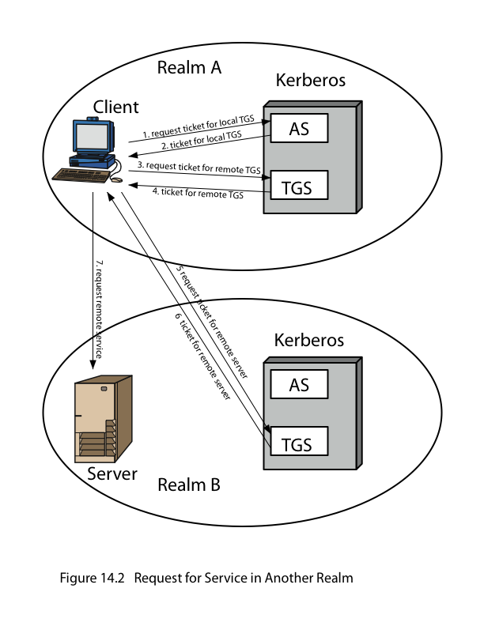
Request for Service in Another Realm
Notes:
Stallings Figure 14.2 shows the authentication messages where service is being requested from another domain. The ticket presented to the remote server indicates the realm in which the user was originally authenticated. The server chooses whether to honor the remote request. One problem presented by the foregoing approach is that it does not scale well to many realms, as each pair of realms need to share a key.

Slide 26
summary of Kerberos realm message exchanges
C -> AS: ID_{C}||ID_{tgs} ||TS₁
AS->C: E_{Kc}[K_{c,tgs} ||ID_{tgs} ||TS₂ ||Lifetime₂ ||Ticket_{tgs}]
C->TGS: ID_{tgsrem}|| Ticket_{tgs}|| Authenticator_{c}
TGS->C: E_{Kc,tgs}[K_{c,tgsrem} ||ID_{tgsrem} ||TS₄ ||Ticket_{tgsrem}]
C->TGS_{rem}: ID_{vrem} ||Ticket_{tgsrem} || Authenticator_{c}
C->V_{rem}: Ticket_{vrem}||Authenticator_{c}

Slide 27
Agenda
Introduction
Motivation
Requirement
Kerberos V4
Kerberos Realms
Kerberos V5
Summary
Test your understanding
References

Slide 28
Kerberos Version 5
developed in mid 1990’s
provides improvements over v4
addresses environmental shortcomings
encryption algorithm, network protocol, byte order, ticket lifetime, authentication forwarding, inter-realm authentication
and technical deficiencies
double encryption, non-standard mode of use, session keys, password attacks
specified as Internet standard RFC 1510

Slide 29
summary of Kerberos version 5 message exchanges

Slide 30
Kerberos Version 5 Flags

Slide 31
Agenda
Introduction
Motivation
Requirement
Kerberos V4
Kerberos Realms
Kerberos V5
Summary
Test your understanding
References

Slide 32
Summary
have discussed:
Kerberos V4
Kerberos Realms
Kerberos V5
Notes:
Chapter 13 summary

Slide 33
Agenda
Introduction
Motivation
Requirement
Kerberos V4
Kerberos Realms
Kerberos V5
Summary
Test your understanding
References

Slide 34
Test your understanding
What problem was Kerberos designed to address?
What are three threats associated with user authentication over a network or internet?
List three approaches to secure user authentication in a distributed environment.
What four requirements were defined for Kerberos?
In Kerberos, when Bob receives a Ticket from Alice, how does he know it came from Alice?
In Kerberos, what does the Ticket contain that allows Alice and Bob to talk securely?

Slide 35
Agenda
Introduction
Motivation
Requirement
Kerberos V4
Kerberos Realms
Kerberos V5
Summary
Test your understanding
References

Slide 36
References
1. William Stallings, Cryptography and Network Security, 6th Edition, Pearson Education, March 2013.
2. Charlie Kaufman, Radia Perlman and Mike Speciner, “Network Security”, Prentice Hall of India, 2002.

